Slide 1
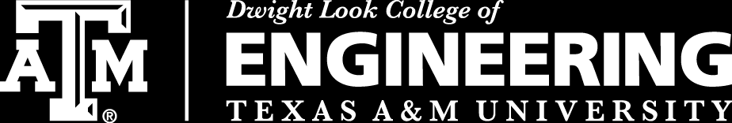
3D Inspection Rover
Team 8
Bi-Weekly Update 3
Sponsor:
Kevin Nowka
TA:
Eric Robles
Team Members:
Chris Dumont
Dalton Hines
Felipe Villegas
Celeste Waters
Notes:
Normal text size and our names are all size 24
Titles are all size 30 except first and last slides

Slide 2
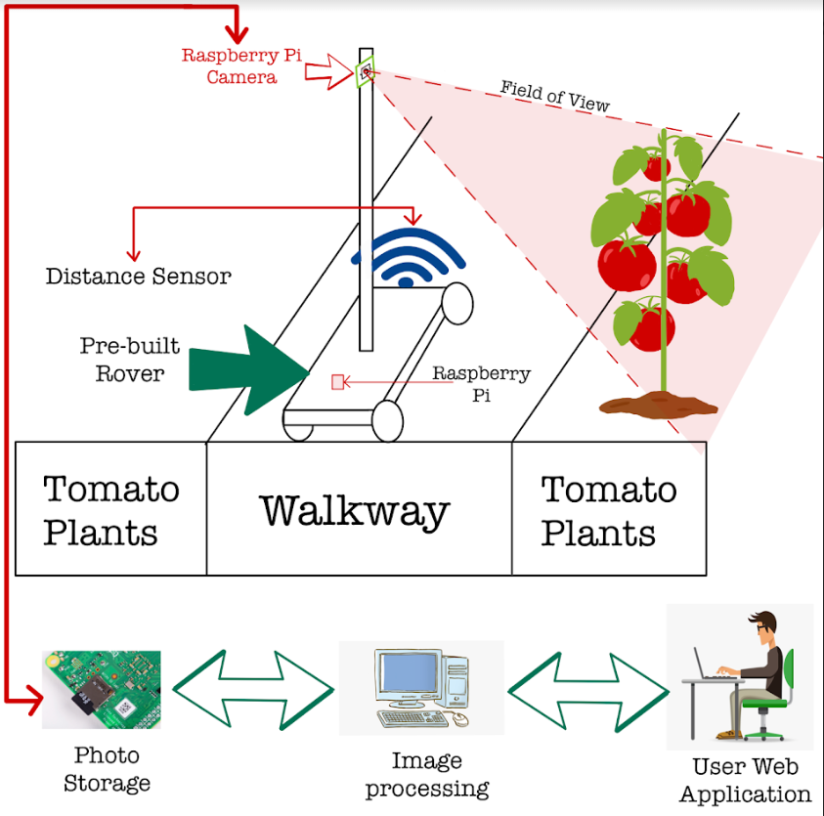
Project Summary
The Problem Is:
Tomato Classification in its current state takes too long
Our Solution Is:
Create a rover that classifies the tomatoes autonomously
Send this data to a database/website that displays yield for the farmer

Slide 3
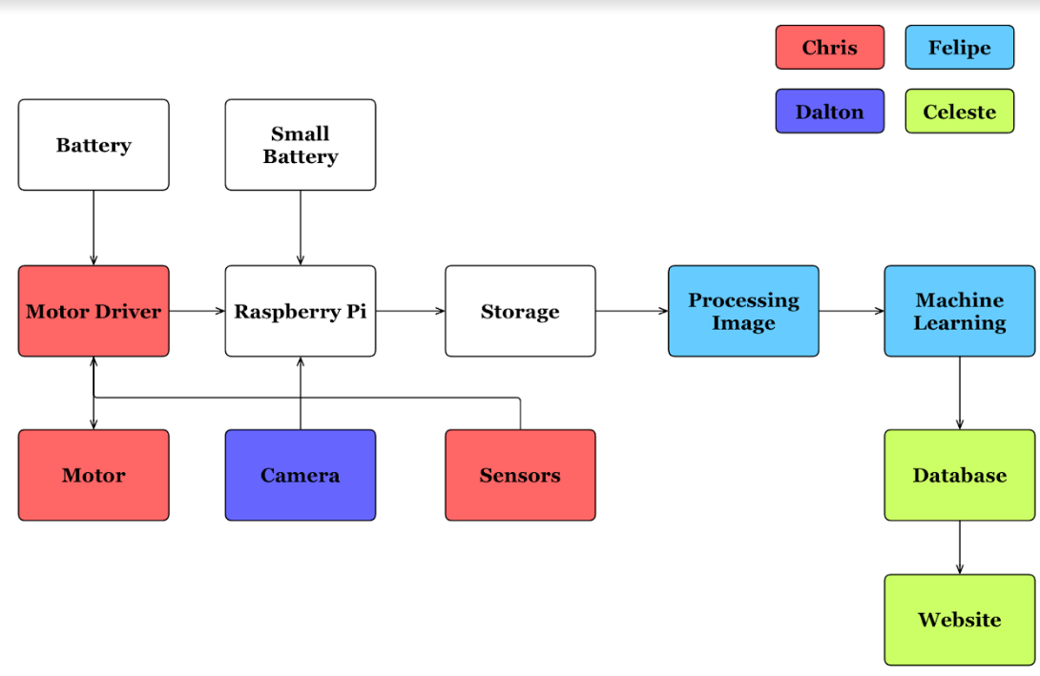
Subsystem Overview
Notes:
Navigation (Red)
Traversing the greenhouse
avoid obstacles in path
Camera Positioning (Purple)
Move Camera up/down mast
Take clear picture of all tomatoes
Image Processing (Blue)
Use machine learning to classify all tomatoes by ripeness
Database/Website (Green)
Save all images
Produce useful charts
Track growth

Slide 4
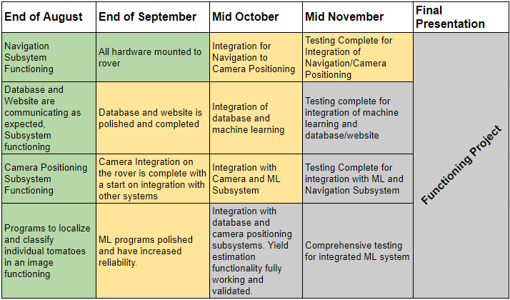
Project Timeline

Slide 5
Navigation & Camera Positioning Integration
Chris Dumont & Dalton Hines
Accomplishments since last presentation ~ 22-25 Hours each | Plans until next presentation
Hardware for gimbal mounting identified All Hardware mounted to rover Circuits integrated Validation begun Camera mounted Distance Sensor Circuit Finished | Mast and Gimble Circuit soldered Gimbal mounting Finish Validation

Slide 6
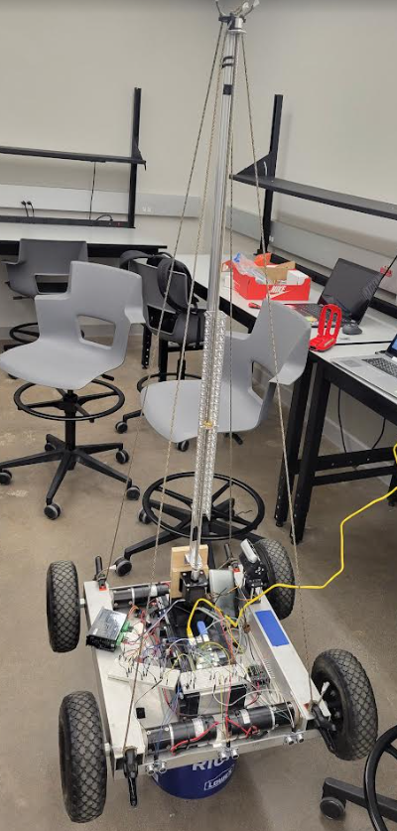
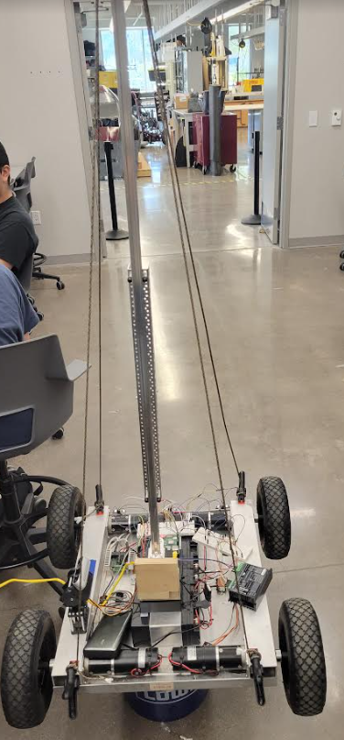
Mast mount and Circuit Integration
Chris Dumont and Dalton Hines
3D printed parts fit securely
Mast does not move during rover motion
Distance sensors do not shift
Nav/Cam circuit runs as intended on one Raspberry PI
Front
Back

Slide 7
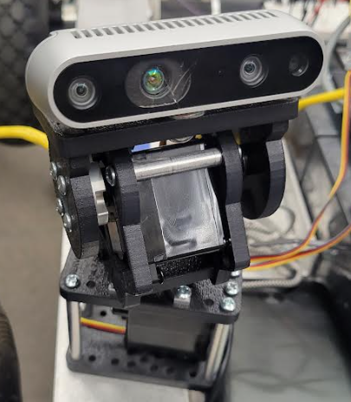
Camera Mounted to Gimbal
Dalton Hines
Camera does not shift during motion
Motors strong enough to move camera

Slide 8
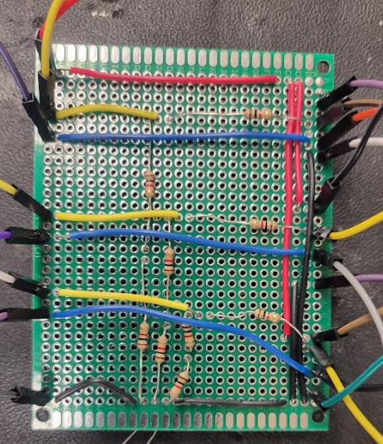
Distance Sensor Circuit
Chris Dumont
Circuit for distance sensors soldered
Has continuity
Needs testing
Raspberry PI
Distance Sensors

Slide 9
Machine Learning Subsystem
Felipe Villegas
Accomplishments since last presentation ~ 20 Hours | Plans until next presentation
Ongoing integration with between ML and DB subsystems ML preparations for camera subsystem integration Volume estimation program ongoing | Integration with Database Subsystem Preliminary Integration with Camera Subsystem Full volume yield functionality and integration

Slide 10
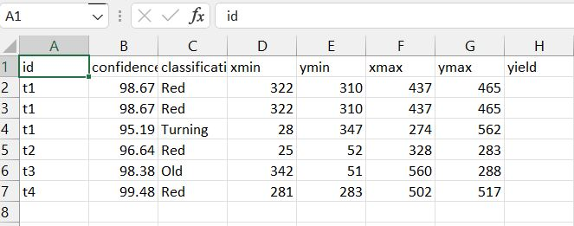
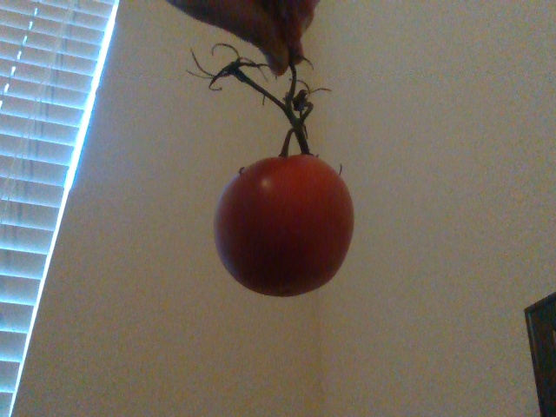
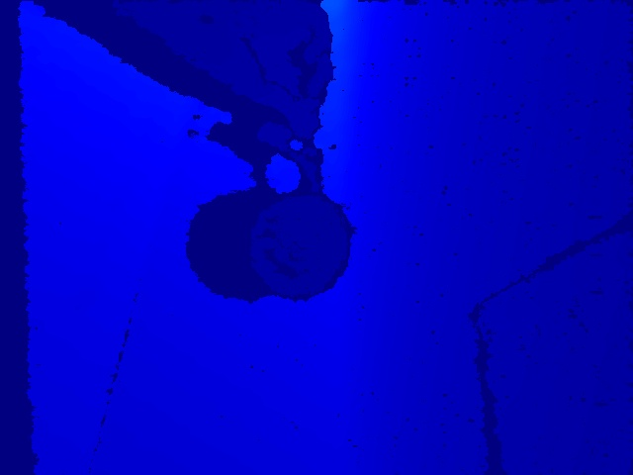
Machine Learning Subsystem
Felipe Villegas

Slide 11
Database/Website Subsystem
Celeste Waters
Accomplishments since last presentation ~20 hrs | Plans until next presentation
On-going functional testing of integration between ML and DB including uploading csv files to display | Full integration between ML and database, displaying to website will be completed by next presentation

Slide 12
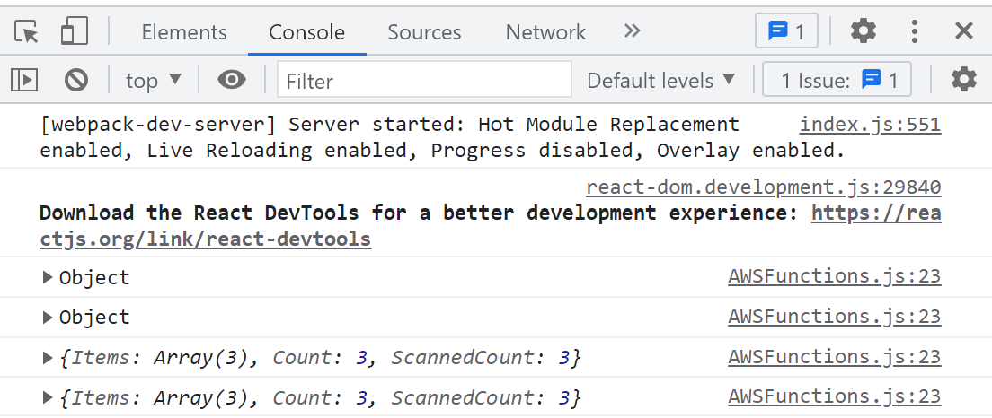
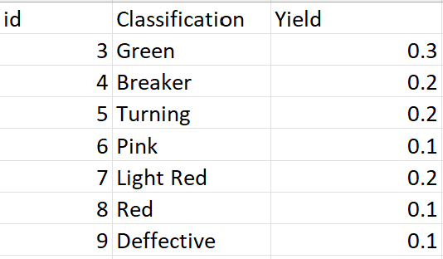
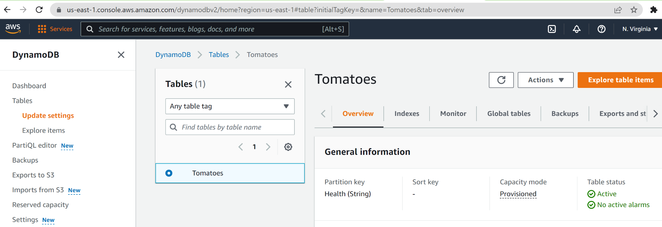
Database/Website Subsystem
Celeste Waters

Slide 13
Parts Ordering Status
Part | Description | Order Placed | Arrived
403 Parts | All Parts needed for 403 | Yes | Yes
C-clamps | Clamp used to secure mast to rover | Available in WEB lab | Yes
Wire | Used to prevent swaying of mast | Available in FEDC | Yes

Slide 14
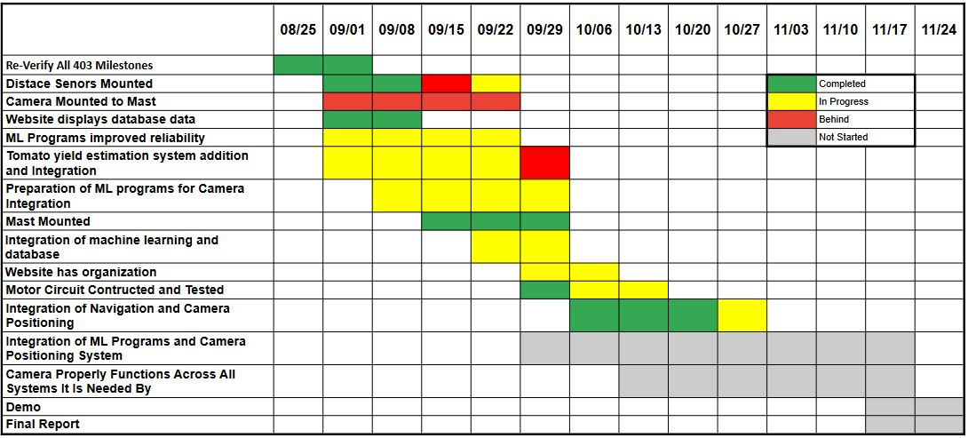
Execution Plan

Slide 15
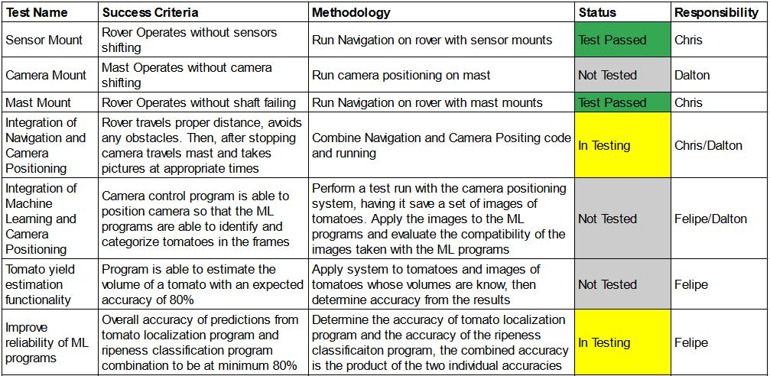

Validation Plan

Slide 16
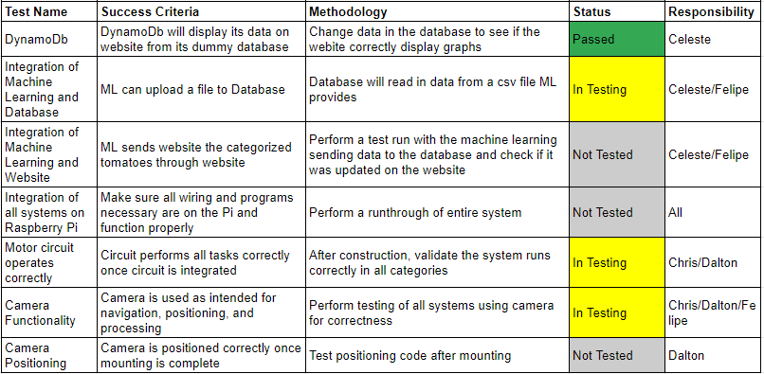
Validation Plan

Slide 17
QUESTIONS

